Slide 1
Elements

Slide 2
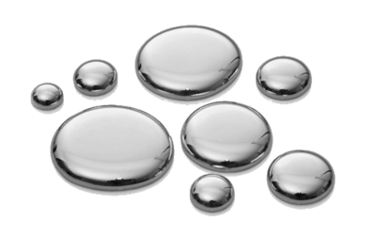
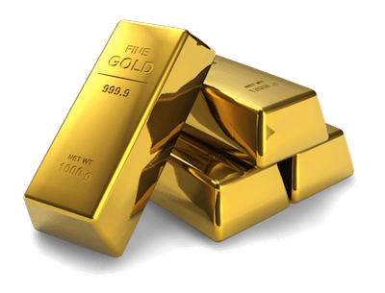
An element is a substance that is made of only one type of atom.

Slide 3

By the end of this Smart Lesson, you should be able to:
1. | Recall that elements are represented by an atomic number, atomic mass and chemical symbol.
2. | Explain that elements contain only one type of atom and have unique properties.
3. | Identify atomic numbers, mass numbers, atomic masses and chemical symbols of various elements.

Slide 4
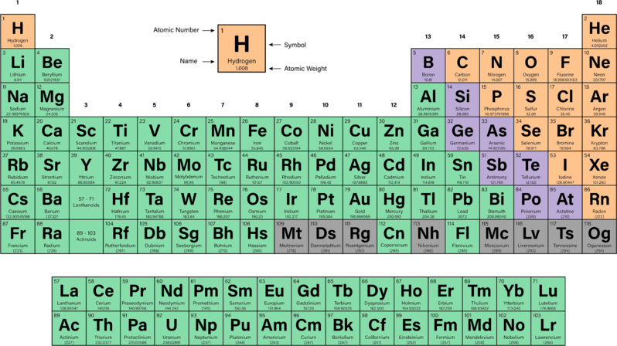
The periodic table organises all of the known elements from smallest to biggest.

Slide 5
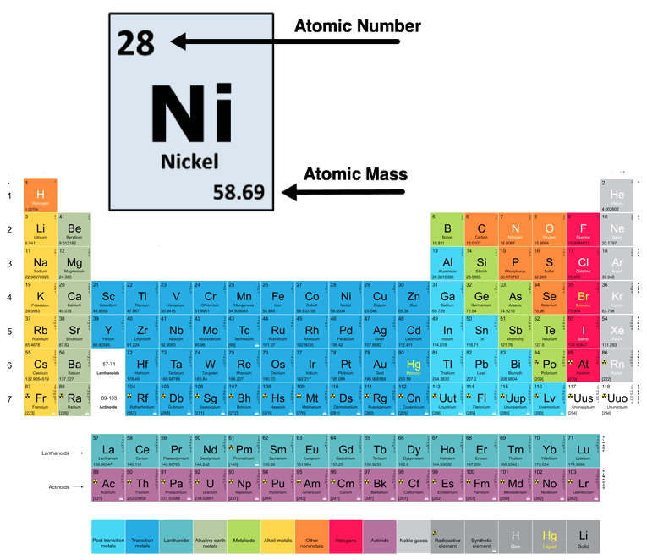
Each element has its own unique box in the periodic table.
Within that box you will notice two numbers.
These are the atomic number and the atomic mass.

Slide 6
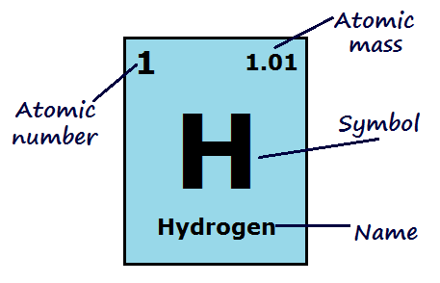
The atomic number is the number of protons in the nucleus of an atom.
This number is used to define elements. This number will be the same for all the atoms of that particular element. We can use the atomic number, or number of protons, to identify an element.

Slide 7
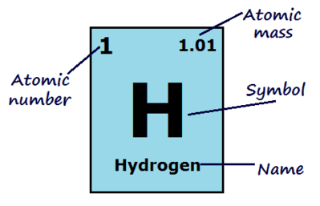
The atomic mass is the average number of protons and neutrons in the nucleus of an atom.
Electrons are not considered, because they are so small that they have almost no effect on the mass.
This is not always a whole number, due to different isotopes existing for each element.

Slide 8
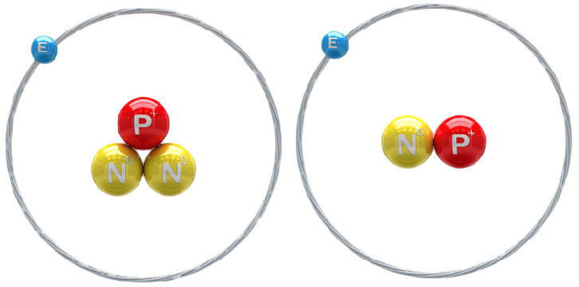
There is also another useful number, the mass number, that is not listed on the periodic table.
The mass number is the total count of protons and neutrons in an atom.
Because the neutron count can vary within an element, we average the different possible mass numbers (based on their abundance) to calculate the atomic mass.

Slide 9
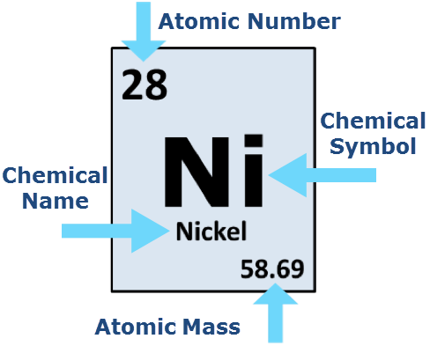
Atomic mass and the mass number are often confused, and people sometimes use them interchangably.
This is because they are used in the same way - to represent the mass of an atom.
But remember that mass number is the mass of individual atoms, and atomic mass is the average mass of all atoms of a single element.

Slide 10
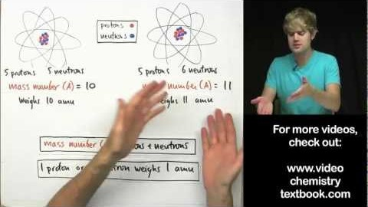
Watch this video (7:24) to learn more about the difference between atomic mass and mass number.

Slide 11
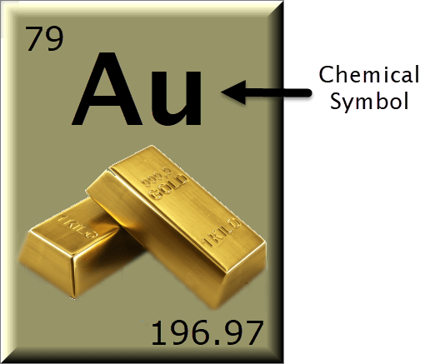
Along with the atomic and mass number, each atom is given a unique chemical symbol.
This symbol represents each element using one or two letters.

Slide 12
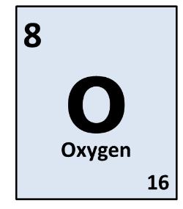
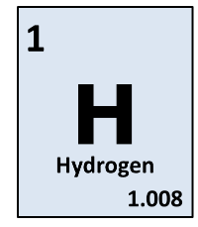
Chemical symbols for the elements are made up of letters of the alphabet.
Many of the symbols are simply the first letter of the element. This letter is always upper case.
For example, H for Hydrogen or O for Oxygen.

Slide 13
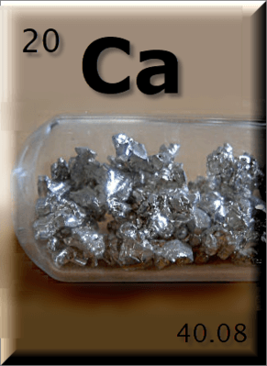
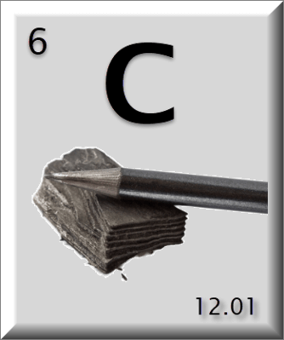
Sometimes we can't just use the first letter.
For example, the symbol for calcium cannot be C, because that is already the symbol for carbon. Instead, we use two relevant letters, Ca.
The first letter is always upper case and the second letter is always lower case.

Slide 14
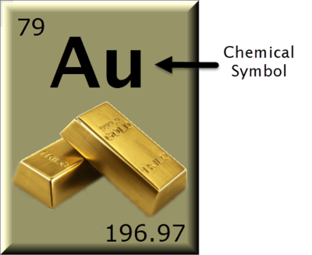
So why do some chemical symbols look like they were chosen at random?
Some elements have symbols that seem really strange. These are usually using one or two relevant letters, but are from another language!
For example, gold is Au (aurum in Latin), tungsten is W (wolfram in German), lead is Pb (plumbum in Latin) and sodium is Na (natrium in Latin).

